Slide 1
Eco Friendly Scrap System
PG Diploma in Advanced Computing By
Swapnali Thorat 210943120107
Pragati Maliye 210943120070
Anuja Ingale 210943120033
Ravina Hazari 210943120032

Slide 2
INTRODUCTION
Eco-friendly Scrap System is working in waste paper, metals, plastic re- cycling management with a goal
to spread awareness about recycling the newspaper and encouraging people to save the paper,
save the trees, save the environment and save the world.
Eco-Scrap intends to help out busy people to throw away and donate scrap for recycling.
You can avail this service upon the request by giving a call or sending enquiry by e- Mail on our application.
Eco-friendly Scrap System invites to join hands and try to help us in re- cycling management.

Slide 3
MODULES
1.Login
2.Admin
3.Customer
4.Donation card
5.View card

Slide 4
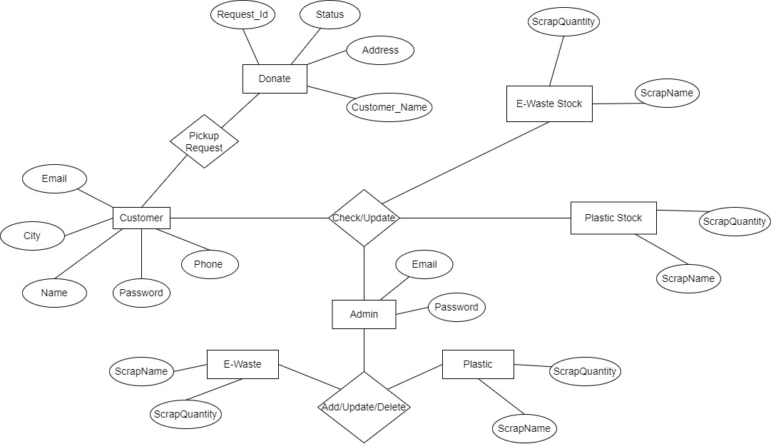

Slide 5
Tools and Technology
Frontend- REACTJS
Backend- Spring boot
Database- MySQL 5.7 with Workbench 8.0
Google Chrome version 79.0
Apache Tomcat

Slide 6
FUTURE SCOPE
Manufacturing companies of all shapes and sizes pay close attention to their scrap rate, as this affects their profits.
To provide a platform for industries to help them to buy and sell scrap as row material for their cost saving
in row material as well as to sell their scrap at good price to increase their profit and ultimately reduce
manufacturing cost. Scope is in all the industries where scrap is their discarded material from a manufacturing job.
So they will use our website to buy row material and sell

Slide 7
THANK YOU...

